Slide 1
Data Analysis & Optimization Team
Stryker Vehicle Data
DISTRIBUTION STATEMENT D. Distribution authorized to the Department of Defense and U.S. DoD contractors only for Administrative or Operational Use (25 April 2007). Other requests shall be referred to the TARDEC Executive Office ATTN: AMSRD-TAR / MS #204, 6501 East 11 Mile Road, Warren, MI 48397-5000
U.S. Army Tank Automotive Research, Development and Engineering Center

Slide 2
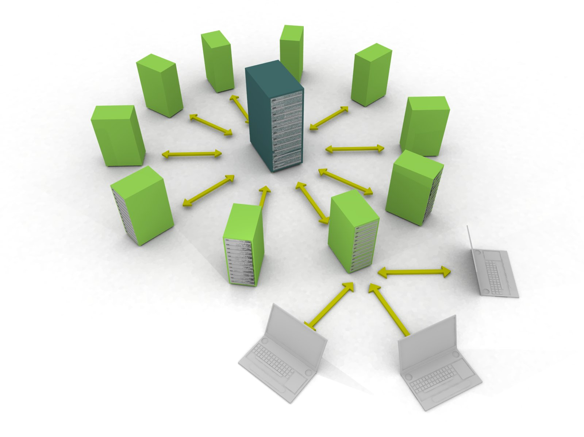
Introduction
CASSI - Analytics - Data Analysis & Optimization
Introduction:
Team is comprised of multidisciplinary individuals with experiences ranging from core engineering expertise to advanced mathematics and software engineering.
Work closely with the Condition Base Maintenance group within TARDEC. Participating with Prognostics and CBM professional communities within industry.
The team is constructing and internal experience stack and tool chain to perform Multidisciplinary Design Optimization.
For Analysis of data sets the team is solidly filled with individuals with strong software engineering skill sets who can easily interface with new systems and standards to rapidly aggregate dispirit data sources for holistic analysis.
Potential Analysis Projects:
Vehicle Subsystem and Component optimization. Trade studies between various component alternatives such as batteries, tires, filters etc.
Analysis of vehicle life cycle measured data and logistics supply chain data to dictate failure criteria based on engineering assumptions, environmental conditions and mission pressures.
Experience
Statistical and Probabilistic Analysis
Structured and Unstructured Data Analysis
Rapid Software Development and Prototyping
Informatics and Information Science, Data Aggregation
Multidisciplinary Design Optimization
Contribution to MDO and Prognostics Communities
Extensive Tool-set Experience

Slide 3
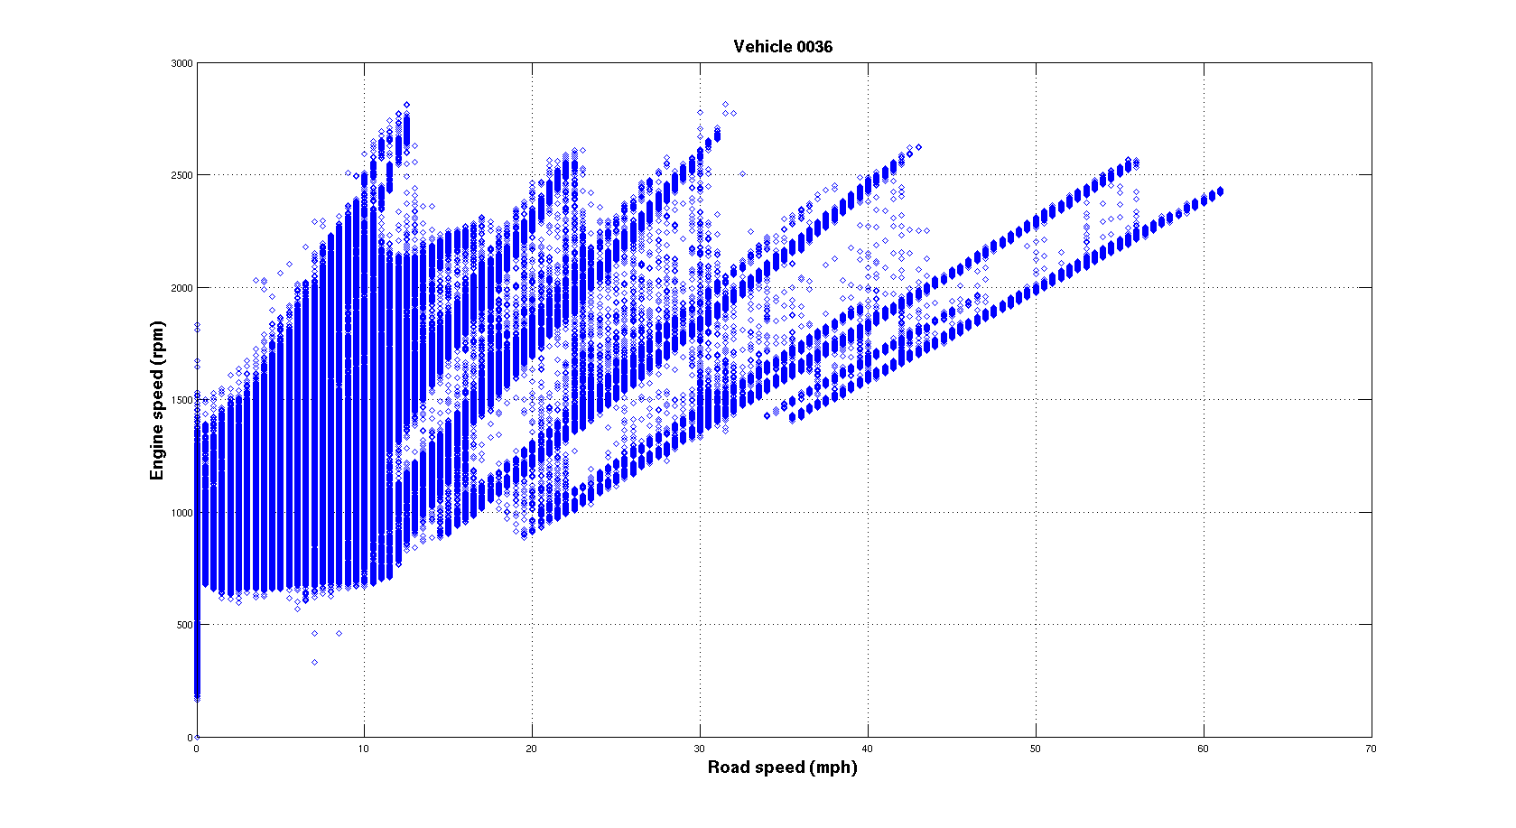
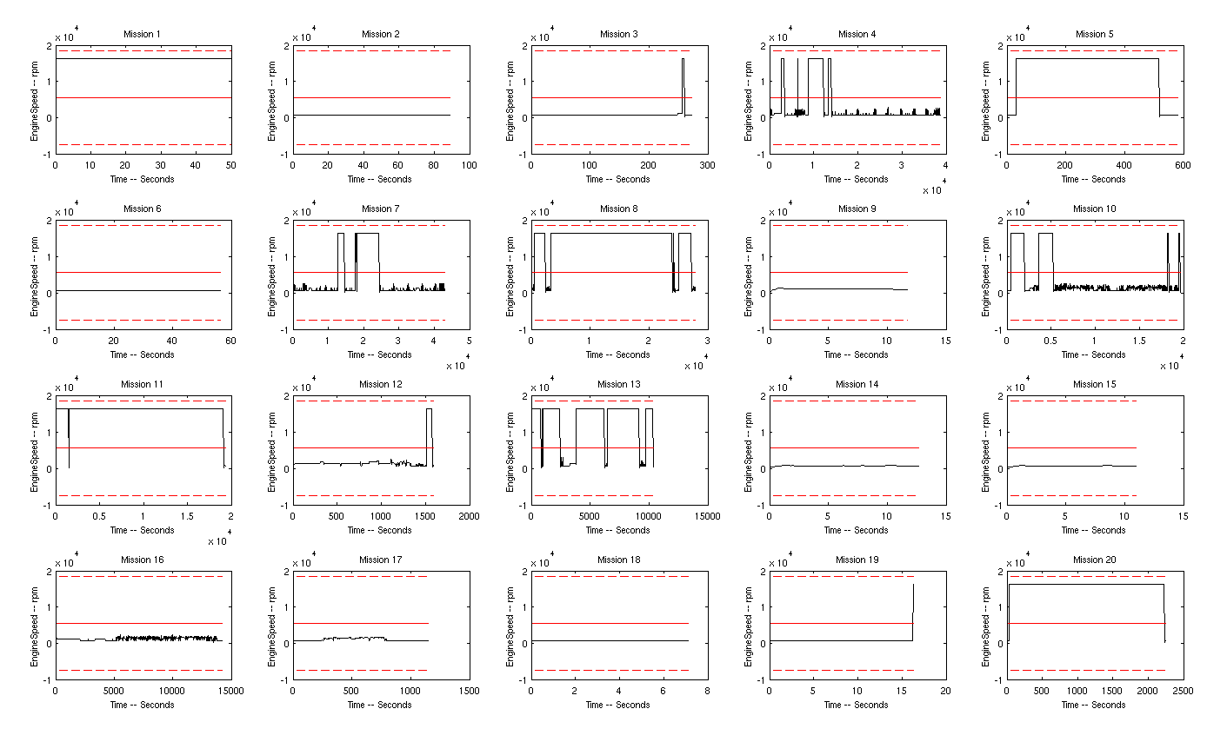
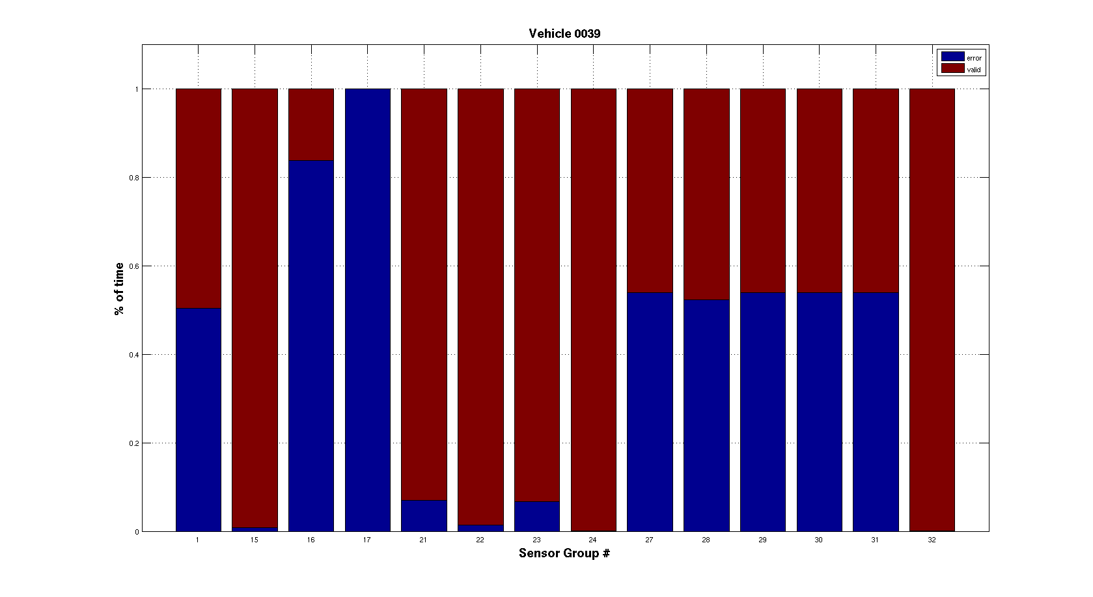
Approach
Extract data from the provided sets for two Stryker Vehicles.
Massage data with various tool sets, commercial and internally developed.
Gain familiarity with provided information. Attempt to identify anomalies and contextual events.
Apply traditional statistical analysis where discerned as possible.
Investigate possibility of designing machine learning analysis with given data.
Peer review and discussion of individual approaches

Slide 4
Quick Results
Verification of Data, diagramming the engine (rpm) as it transitions through
Different road speeds. Aggregated for single vehicle over sampling life cycle.

Slide 5
Quick Results

Slide 6
Quick Results

Slide 7
Desired Information
Necessary additional data for value added analysis:
Documentation of all relevant events (Part replacement, etc.)
  Need both nominal and pre-fault sets of sensor data learn how to predict failure
Explicit specifications of the vehicle variant, configuration, operation, etc.
  Variants with different modifications, weights, and mission profiles cannot be assumed to have similar component decay profiles. All of this contextual information must be recorded for valuable analysis.
Explicit specification of the sensor design, behavior and installation*
  Context surrounding what sensor data is incredibly important to assist in identification of sensor fault.
  Sensors will have specific idiosyncrasies that need to be enumerated for proper confidence of analysis.
Desired Additional Information for value added analysis:
Reliable sensor performance, confidence indicators from the experiment designers*
  Appears that more than 1/3 of measured data is unusable
  Possible installation failure, contextual reasoning for enable/disable
Sensor “stale/malfuctioning/max” value of zero instead of arbitrary maximums*
  Arbitrary value reporting will significantly distort means, standard deviation and all other statistical measurements.
  Rejection criteria is unknown due to some max values being in acceptable operational range.
* Possible that through contextual awareness some of these questions would be alleviated, pedigree of data is in question until team is able to discern exactly what intent was from measurement source.

Slide 8
Possible Studies
Traditional Statistical Analysis:
Analysis of Means (ANOM)
Analysis of Variance (ANOVA)
K-means Clustering
  Possible to use various statistics to establish “nominal” sensor data profiles for vehicles with means and standard deviations. If sensor data deviates consistently and far enough from the mean then it can be an indication of failure.
Machine Learning Analysis:
Bayesian Networks (naïve or standard) (BN)
  From nominal and pre-fault data, build a network that is based on current sensor data and gives a failure probability for a component in a given time interval. Use a threshold to indicate when to replace.
Neural Networks (NN)
  Similar to Bayesian Networks, however one gains the ability to utilize nonlinear dependence at the cost of being less transparent.
Hidden Markov Models (HMM)
  At the simplest level; a Bayesian Network with a time history of past sensor readings. This would allow for greater accuracy due to historical information being included in the inference process, but adds to the complexity cost.
Fuzzy Logic Inference
  Combines sensor data inputs with a fuxxy reasoning based rule set (general value as opposed to value models) to give a precise predicted output.
Genetic Algorithm (GA) or other Function based Data Mining
  Look at the entire set of data with events and generate hypothetical failure models. Test and evaluate their efficacy, use the best to create a new batch of models and continue until accurate models are achieved.

